Slide 2

Xamarin 101

Slide 3

Xamarin
iOS C# UI
Android C# UI
Windows C# UI
Shared C# Logic
Shared C# codebase • 100% native API access • High performance

Slide 4


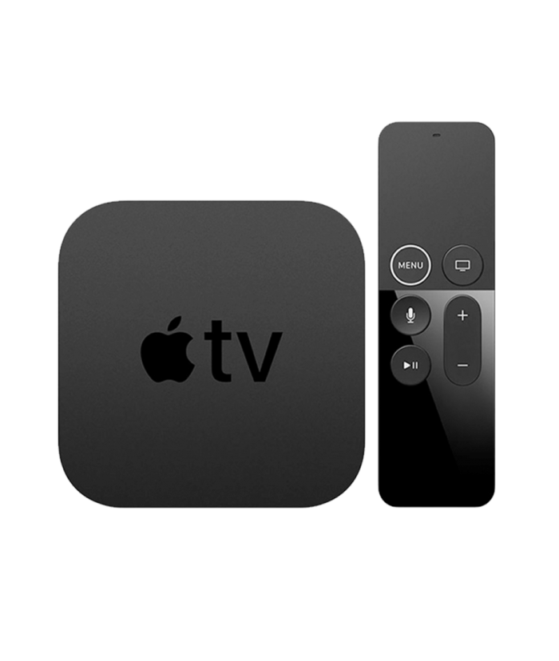

Xamarin
iOS C#
Android C#
Windows C#
Shared C# Logic
3 Native User Interfaces
Shared App Logic

Slide 5
Everything you can do
in Objective-C, Swift, Java or Kotlin
can be done in C# with Xamarin

Slide 6
Xamarin
+ Xamarin.Forms
iOS C# UI
Android C# UI
Windows C# UI
Xamarin.Forms
Shared C# Logic
Shared C# Logic
Traditional Xamarin approach
With Xamarin.Forms: More code-sharing, all native

Slide 7

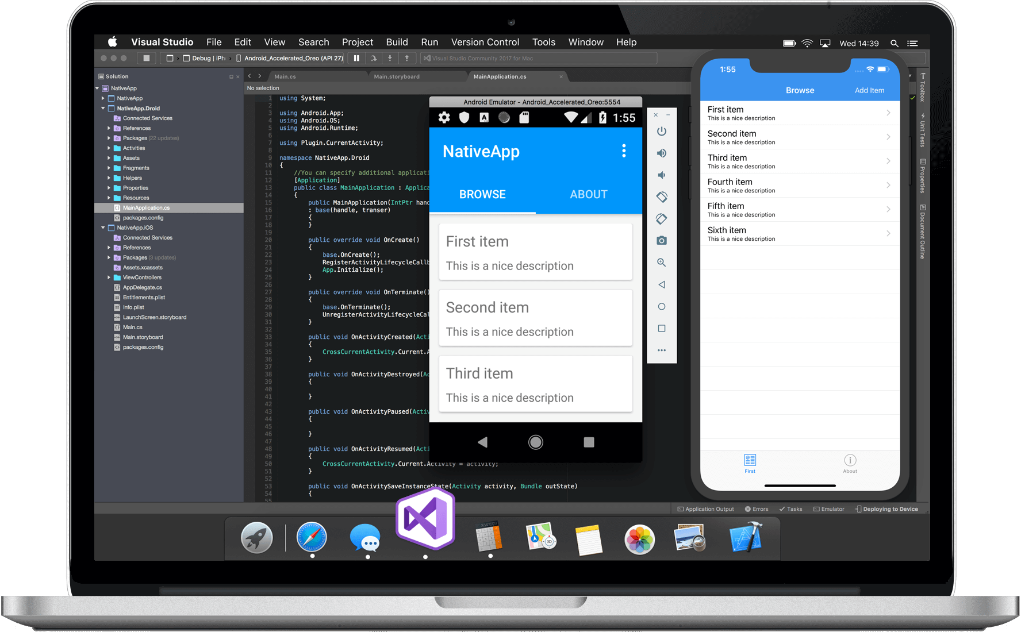
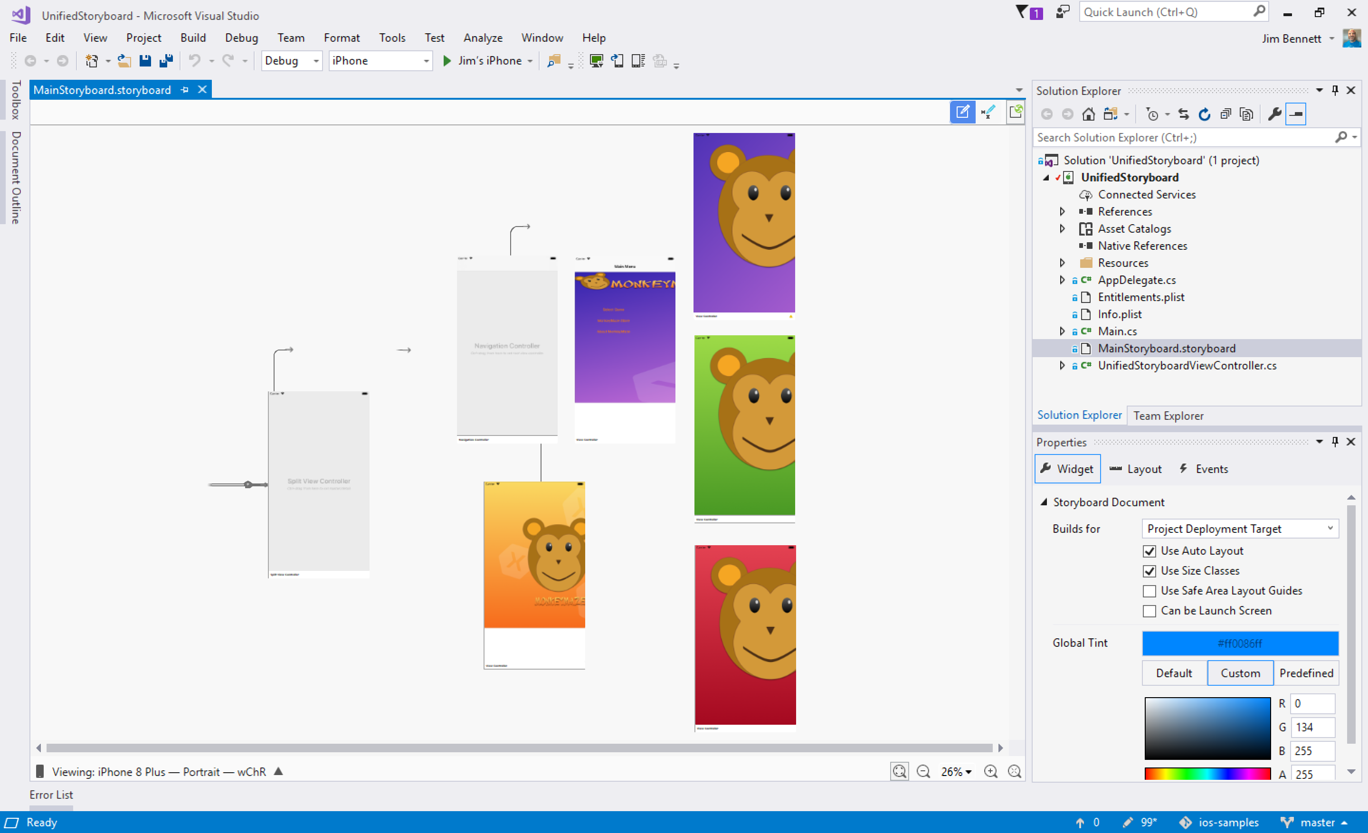
Visual Studio (PC)
Visual Studio for Mac

Slide 8
Quick Review

Slide 9
Xamarin
Native Mobile Apps in .NET
Create native iOS apps
Create native Android apps
Xamarin.Forms
Share UI Code
Visual Studio
Develop in Visual Studio (PC)
Develop in Visual Studio for Mac

Slide 11
Presentation Slide

Slide 13
Demo intro slide

Slide 14
Code Sample Title

